Slide 1
News Article Summarization
Group 16
GROUP MEMBERS:-
BHAVSAR DARSHAN VIJAYKUMAR(19BECE30028)
PRACHI JETHAVA(19BECE30140)
JAIN SHREYAS SUNILKUMAR (19BECE30183)
PROJECT GUIDE: Prof. Sandeep Modha

Slide 2
Problem Statement
News articles are often too long to read, all users want is a summary.
Readers want to save time but also be aware of what’s happening worldwide.
Previously, summarization was done by humans which takes lot of time. Thus, automated summarization is required which can save a lot of time.

Slide 3
Introduction To Summarisation
The word data summarization is nothing but extracting and presenting the raw data as a summary of it.
The goal of Summarization is to produce a shorter version of a source text by preserving the original document's meaning and key contents.
A well-written summary can significantly reduce the amount of work needed to digest larger amounts of text.

Slide 4
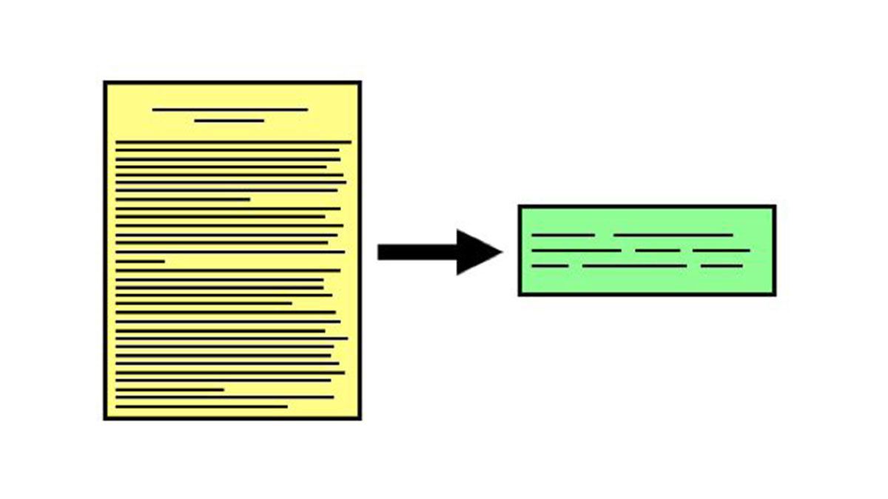
Summarization systems can be used to highlight the important content of the documents.
This technique is used to save time and to fetch important parts of the News Article. The News Article is long and sometimes they contain vital information but due to more length of the article, generally, this information is missed. Thus, Summarization helps to fetch concise and accurate data.

Slide 5
Types of Summarisation
There are two types of summarisation:
Extractive Summaries
Abstractive Summaries

Slide 6
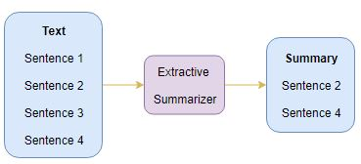
Extractive Summaries
The extractive approach involves picking up the most important phrases and lines from the documents. It then combines all the important lines to create the summary. So, in this case, every line and word of the summary actually belongs to the original document which is summarized.

Slide 7
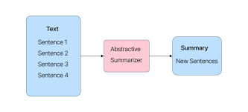
Abstractive Summaries
Because they do not choose specific passages from the source text to summaries, abstractive summarizers get their name.
Instead, it paraphrases the text's essential points using a vocabulary set that differs from the original text.
Then, to construct a succinct summary that captures all the main elements of the real document, we choose words from our general vocabulary set that fit the semantics.

Slide 8
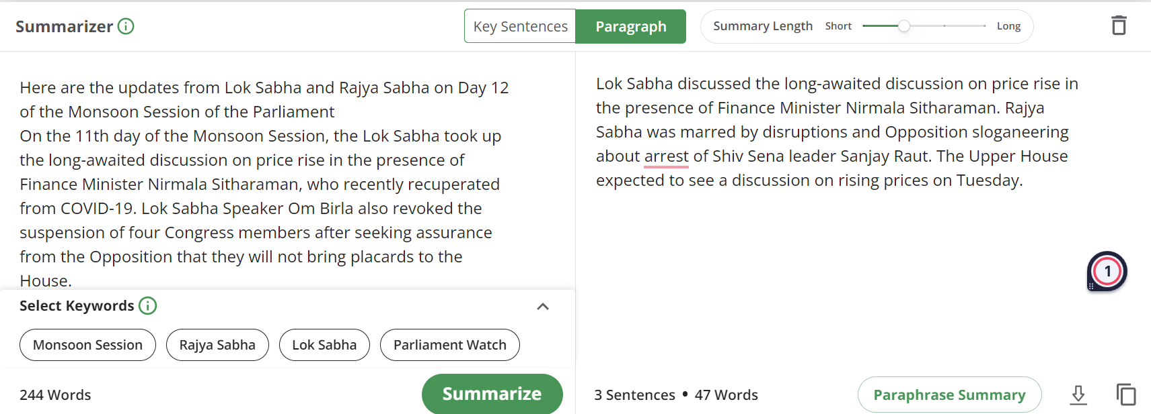



Slide 9
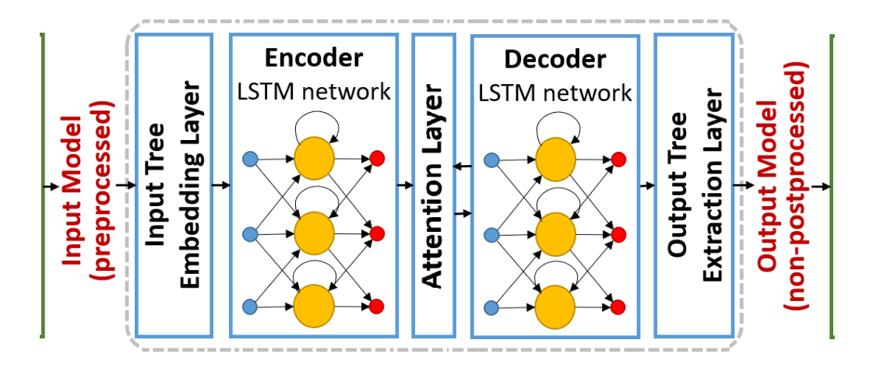
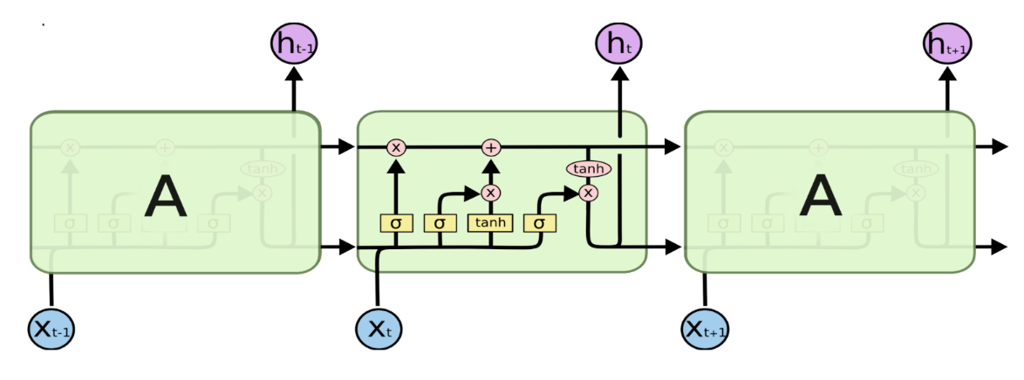
LSTM ARCHITECTURE

Slide 10
Solution
To create an appropriate machine learning/deep learning model that generates a meaningful fixed length summary of the news article.
For this, we are using a dataset which contains articles and summary pairs from several leading newspapers of the country.
By using this data, we can use natural language processing and deep learning to provide a solution.
A web application is then built which is integrated with the model built.
A feature is integrated with web app using which authors can login/sign up to website and submit details of news articles published by them and this data can be added to our dataset.

Slide 11
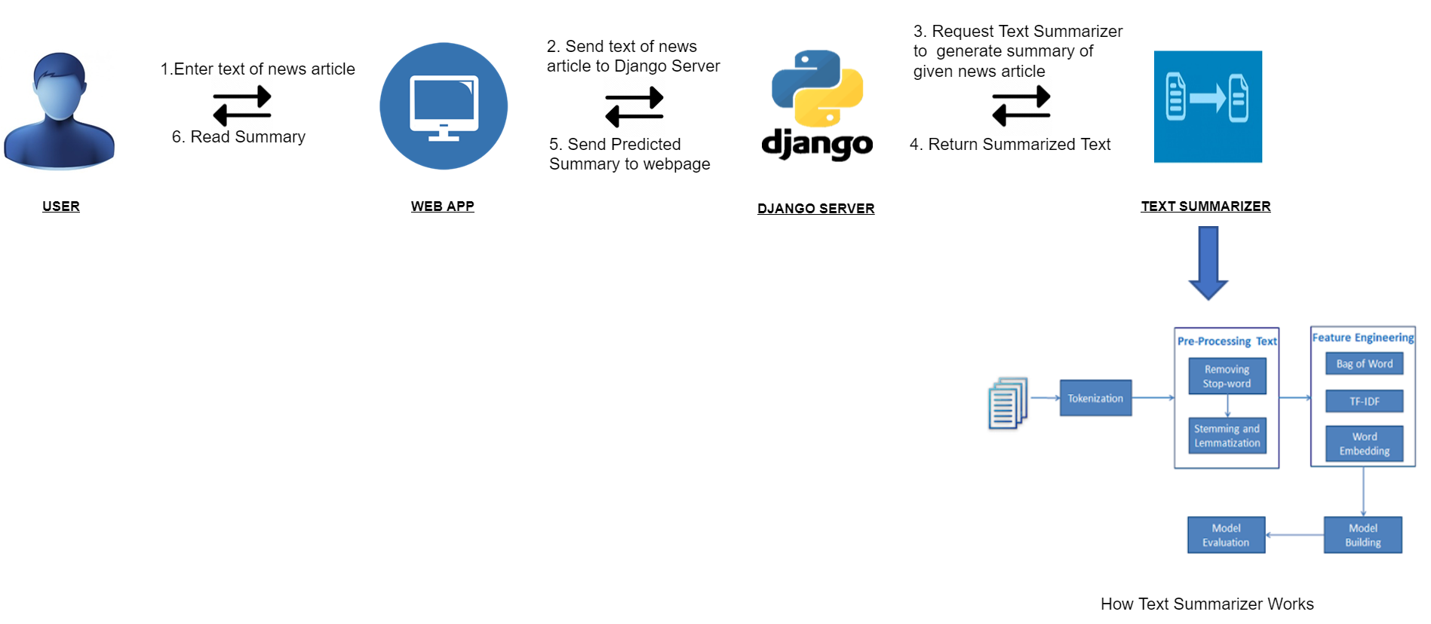
Workflow

Slide 12
Impact
A normal reader can read more news by spending the same amount of time.
A similar model can build up in different regional languages.
Automated Summarization saves a lot of time compared to summarization done by humans.

Slide 13
Tech and tools
ML Model - Python and its libraries like pandas, matplotlib, seaborn, NumPy, sci-kit learn, deep learning, natural language processing, spacy, Jupyter Notebook.
Backend - Django framework, Pycharm
Frontend – HTML, CSS, Bootstrap, Javascript, vscode

Slide 14
Future Prospects
Accuracy of the abstractive summarizer can be increased through better training of the model.
Auto-generated questions can be created from the given news article.
Auto-generated MCQ can be created from the given news article.
Sentiment analysis can be done on a given article, which can be further used for tone detection.
We can scrape news articles from different websites in real time and keep their summary on the website.

Slide 15
Thank you

